Slide 1


Fire Bird
By
Arpit Chauhan (2019CS10332)
Aman Gupta (2019CS10673)

Slide 2
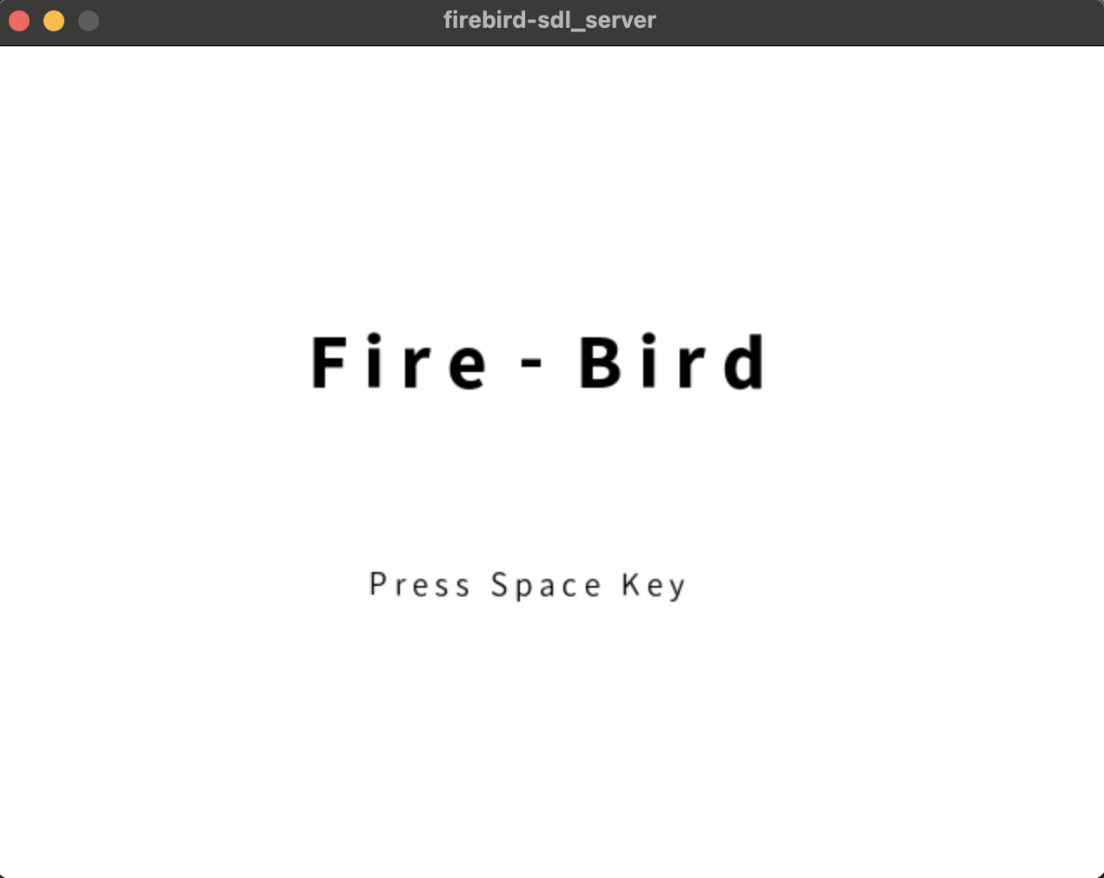
This is how the start page of the game looks, there are two modes in which you can start the game by passing argument while running the executable.
The two modes are :
Server : Hosts the game and send some one-sided info like maze structure and enemy position and handles player 1
Client : Receives information and handles player 2 in case of a multiplayer game

Slide 3
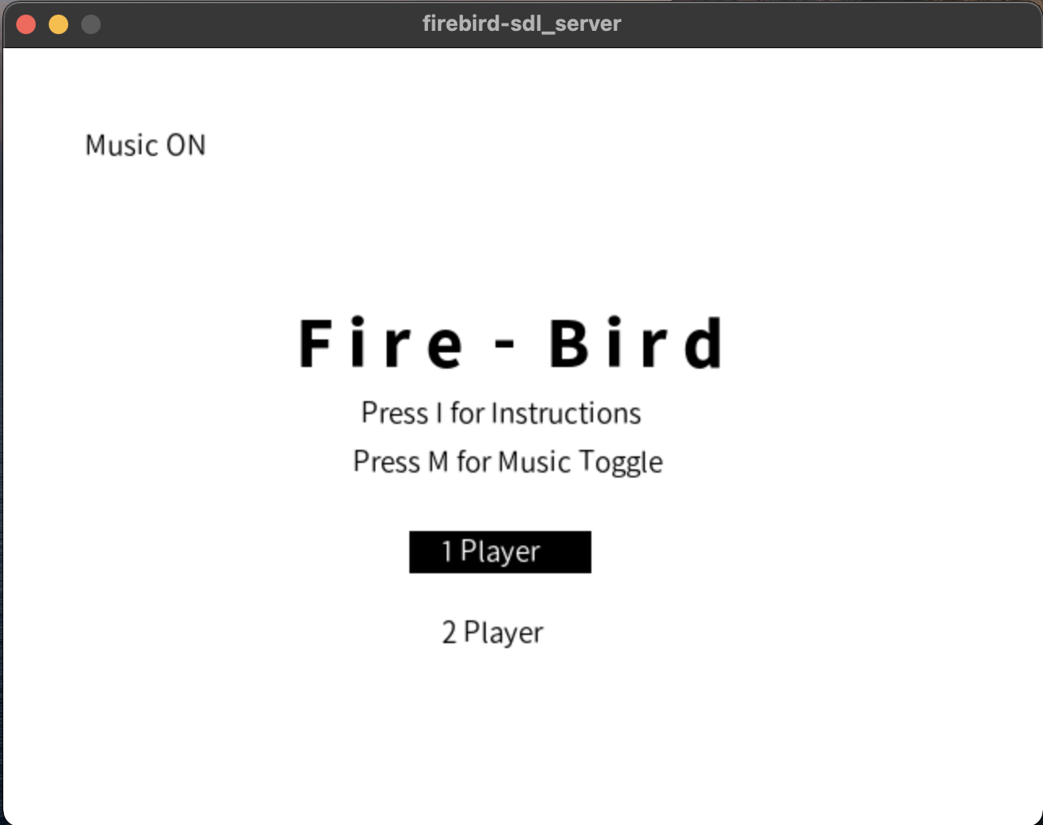
On pressing Space on the previous screen you would see the self-explanatory menu page.
Pressing M key would toggle the music option shown on the top left corner.
Pressing I key would open instruction page.
Use Up-down key to change and space key to select between single player and multiplayer mode.

Slide 4
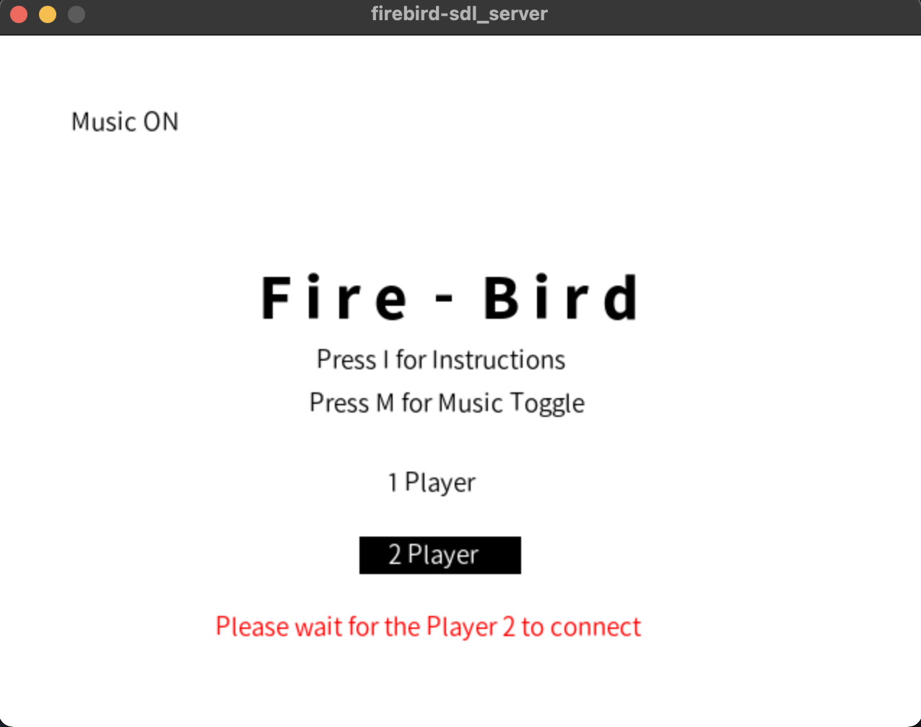
On selecting two player mode as the server/player 1 you would receive a message to wait until the client/player 2 connects. On connecting it will automatically start the game.

Slide 5
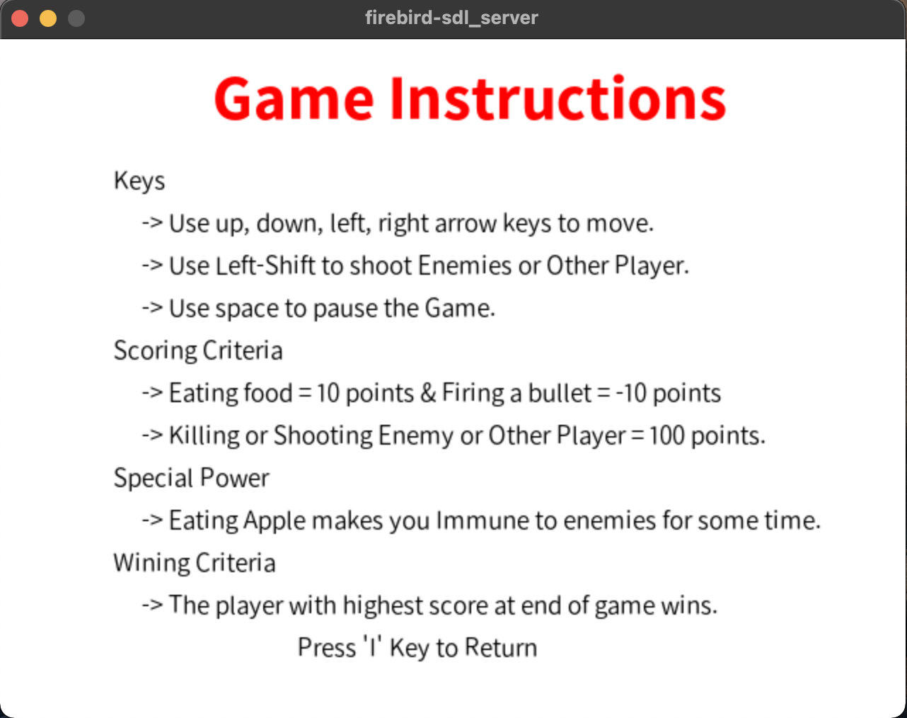
On pressing I key on the main menu option the window would transfer to the Instruction page which has all the details about the game.
On pressing I key here you would return back to the menu page.

Slide 6





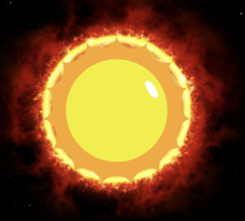
Maze and Characters
Block | Description
 | Represents wall in the game and is impenetrable to players, enemies or bullets.
 | Player 1 in the game.
 | Player 2 in the game.
 | Power food which provides immunity to players against enemies.
 | 4 such Enemies
 | Bullets fired by players.

Slide 7
Special Features
Middle left and right corner of the game are interconnected and player entering the left wrap would emerge from the right wrap and vise-versa
Bullets can kill enemies and other player.
On being hit an enemy goes back to its home and gets respawned. During this going back it will not kill the player on coming in contact.
Random maze will be created each time on playing the game so that the players don’t get used to the same maze.
Each action on the game is characterized by a special music effect.
If one player uses the pause option the game gets paused for the other player too.
The two games are completely synchronized in all aspects.
The travelling speed of enemies increases with subsequent levels thereby increasing its difficulty.

Slide 8
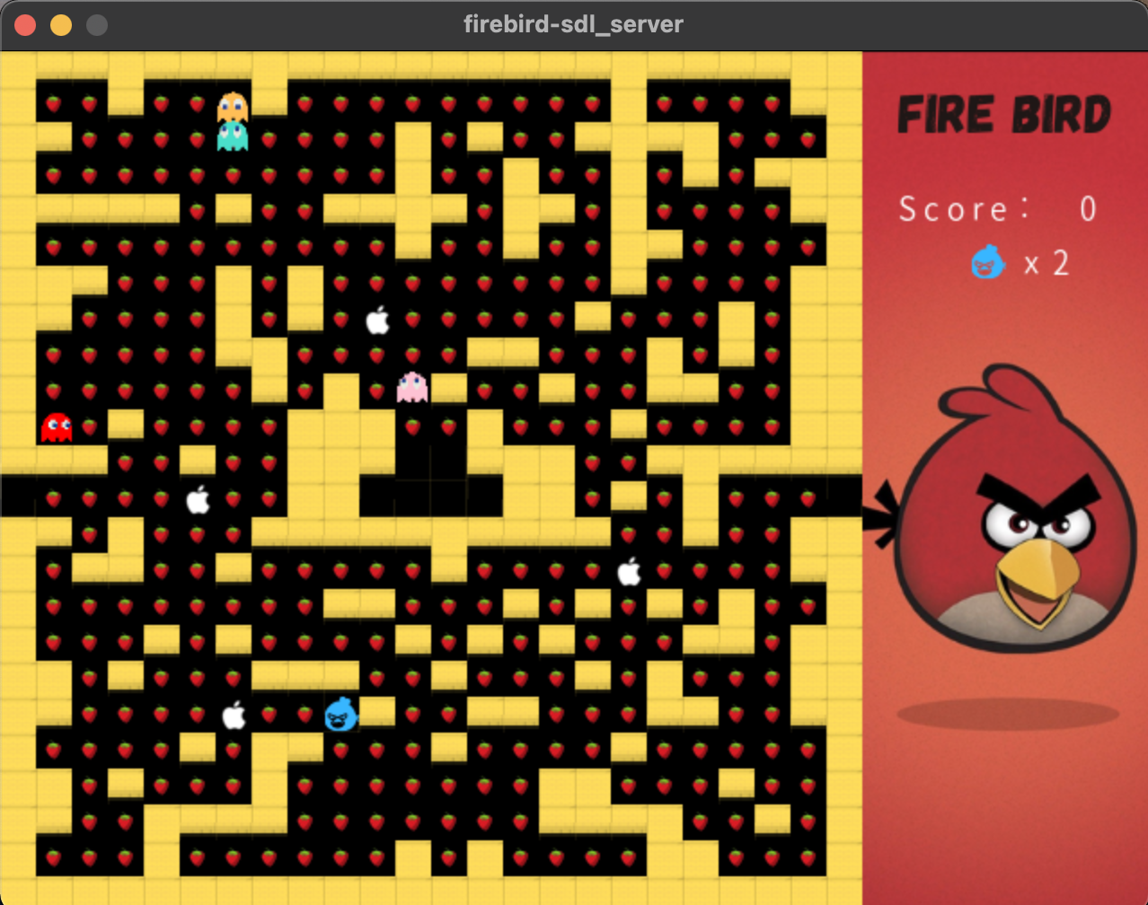
Single Player Mode:
Score and the number of lives left for the player are shown on the right panel.

Slide 9
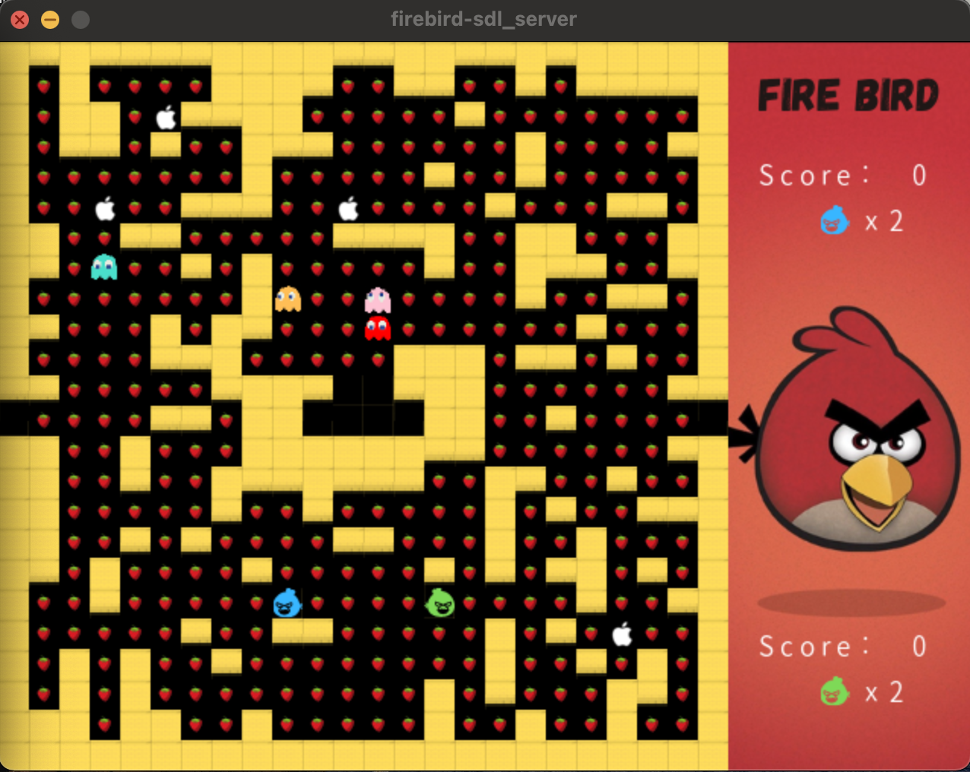
Multiplayer Mode:
Score and the number of lives left of the two player are shown on the right panel.

Slide 10
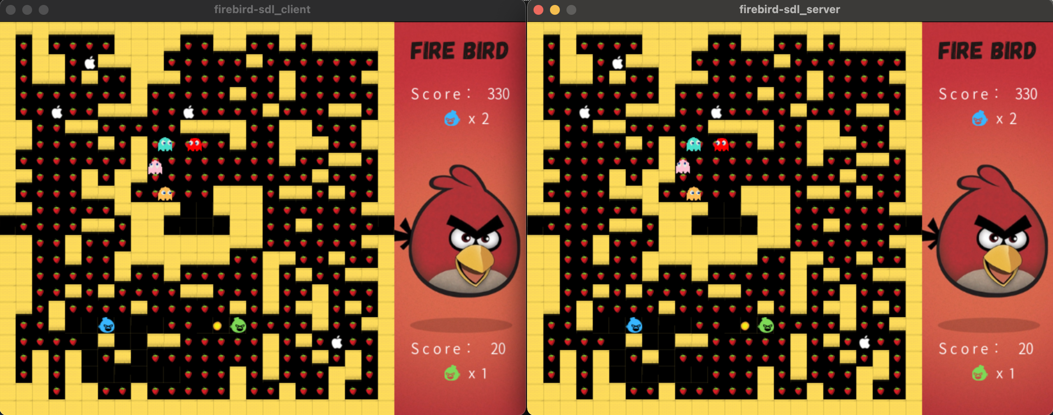
Networking using Sockets:
The two synchronized screens on two terminals establishing a peer-to-peer connection

Slide 11
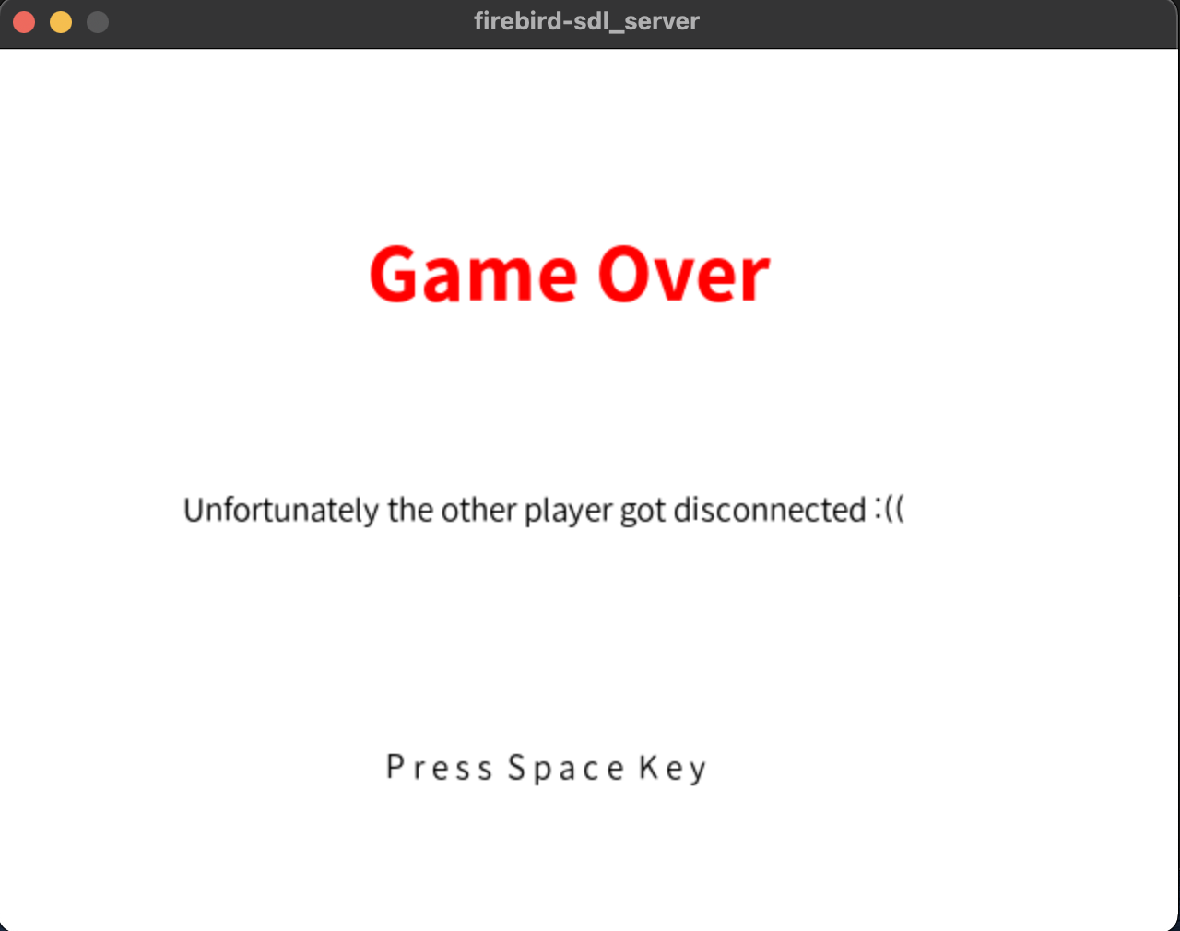
Connection Failed:
If one of the player in the multiplayer game mode gets disconnected then the other player receives this message.

Slide 12
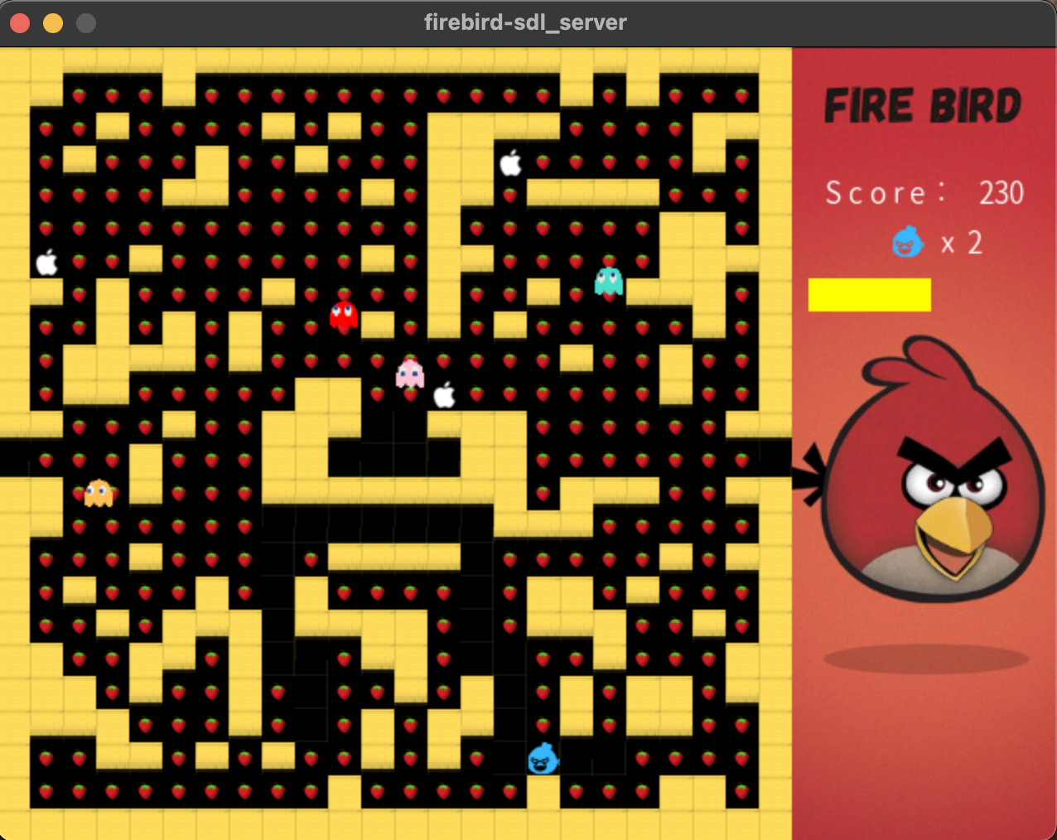
Power Mode:
Indication and duration of the power mode left is shown by the yellow time bar on the left panel.

Slide 13
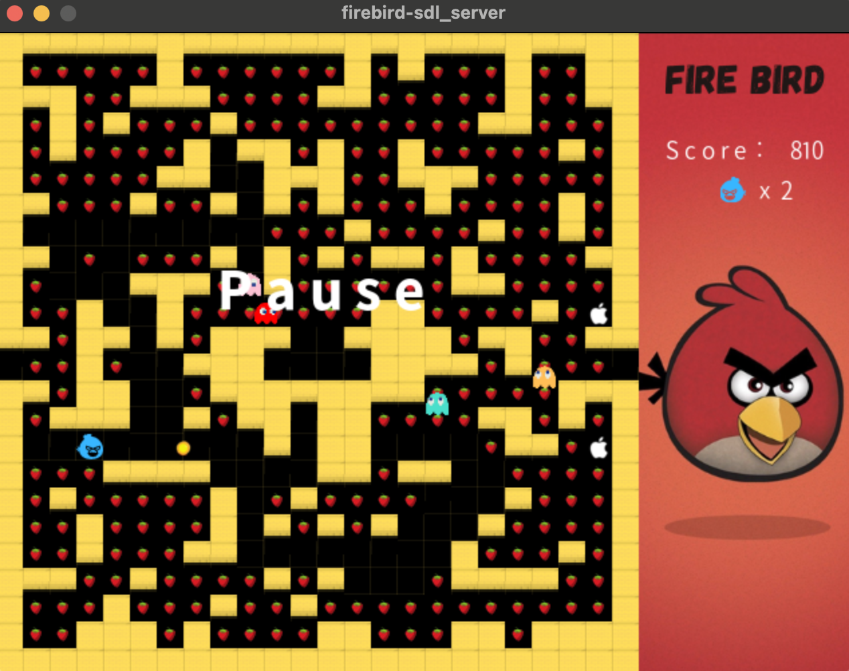
Pause option and Bullet:
This frame shows the pause option and player 1 firing a bullet.

Slide 14
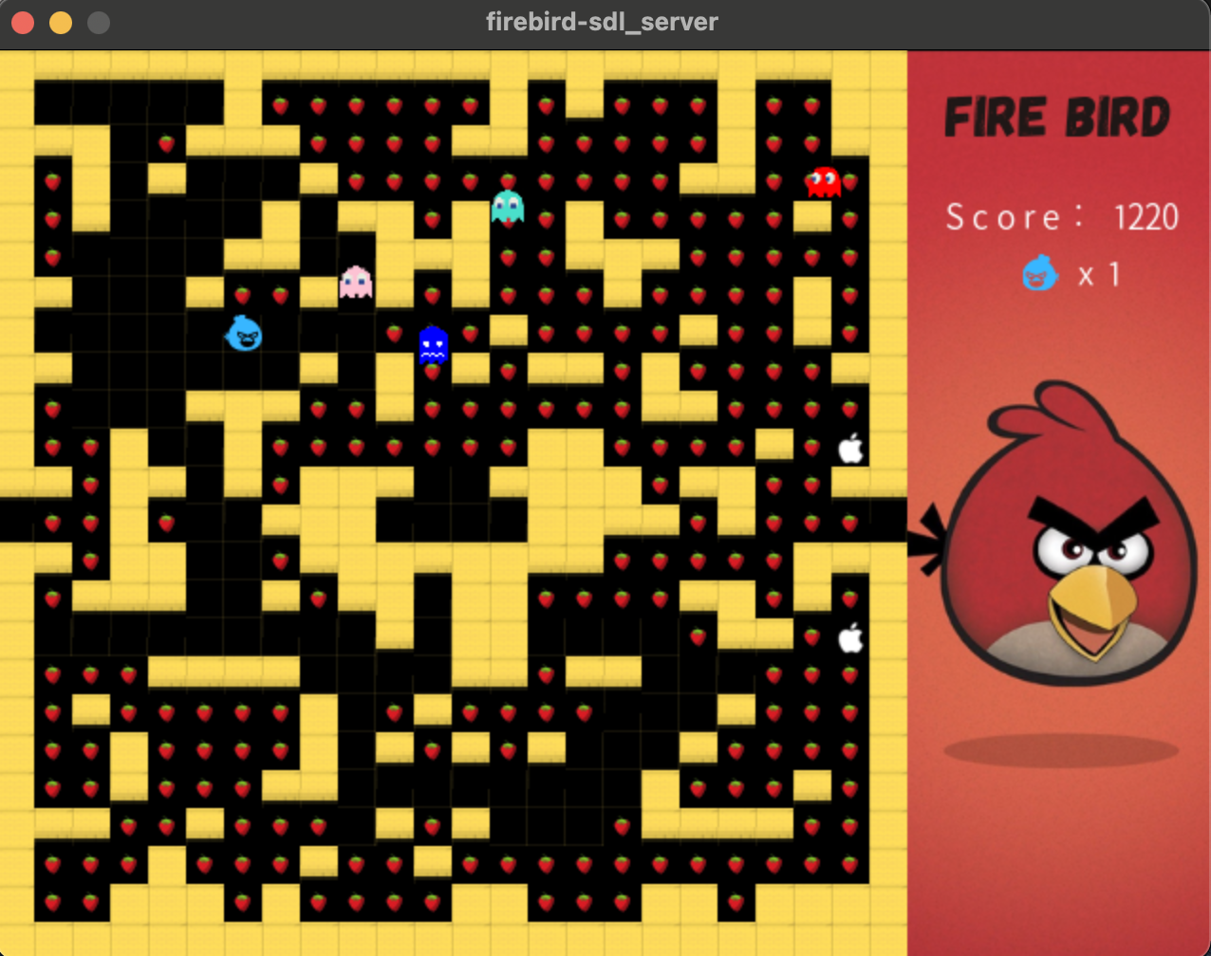
Enemy hit Mode:
This frame shows the injured enemy (In blue) going back toward its home.

Slide 15
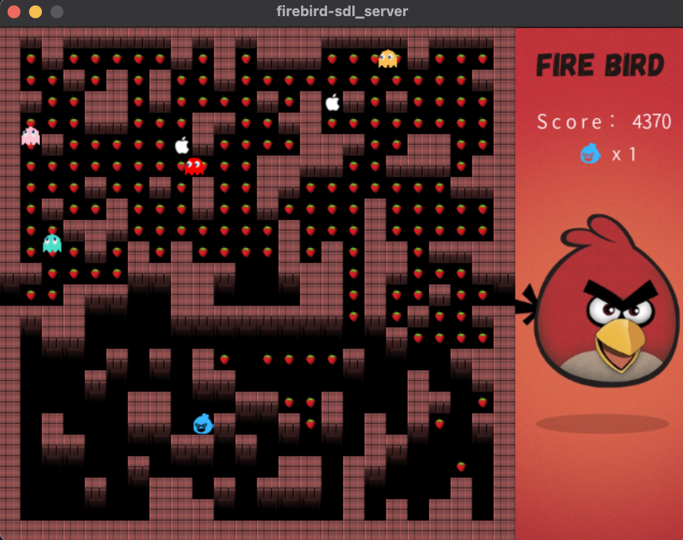
Level 2:
This frame shows the second level of single player game. It involves enemies at higher speed.

Slide 16
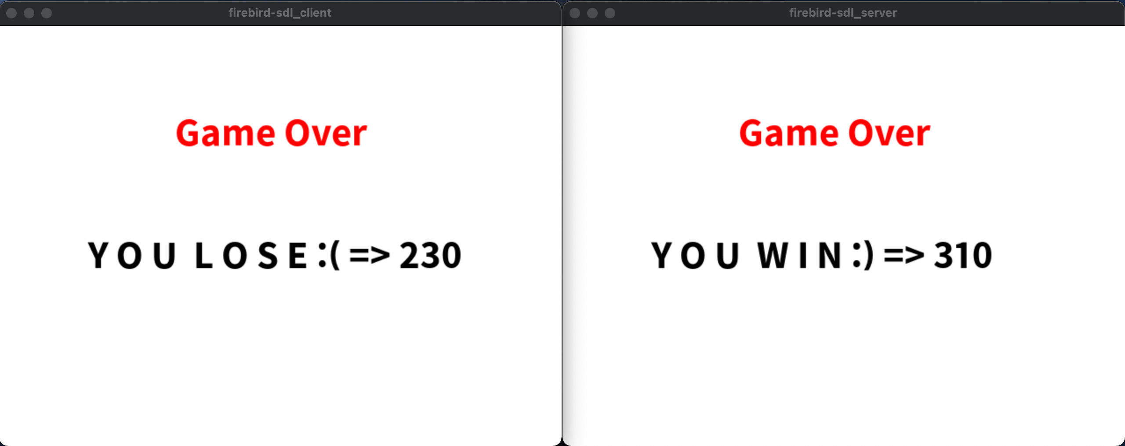
Game over mode:
This frame shows the finished game state, winning player, losing player and their respective score.

